Slide 1


Delta Live Tables (DLT)

Slide 2
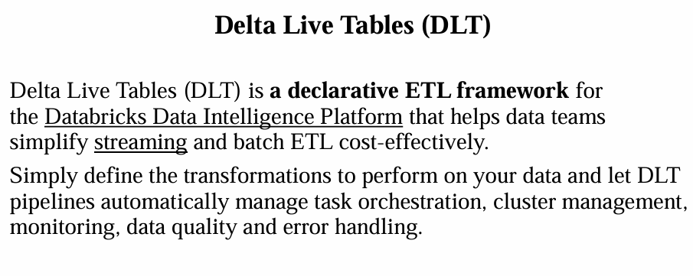

Slide 3
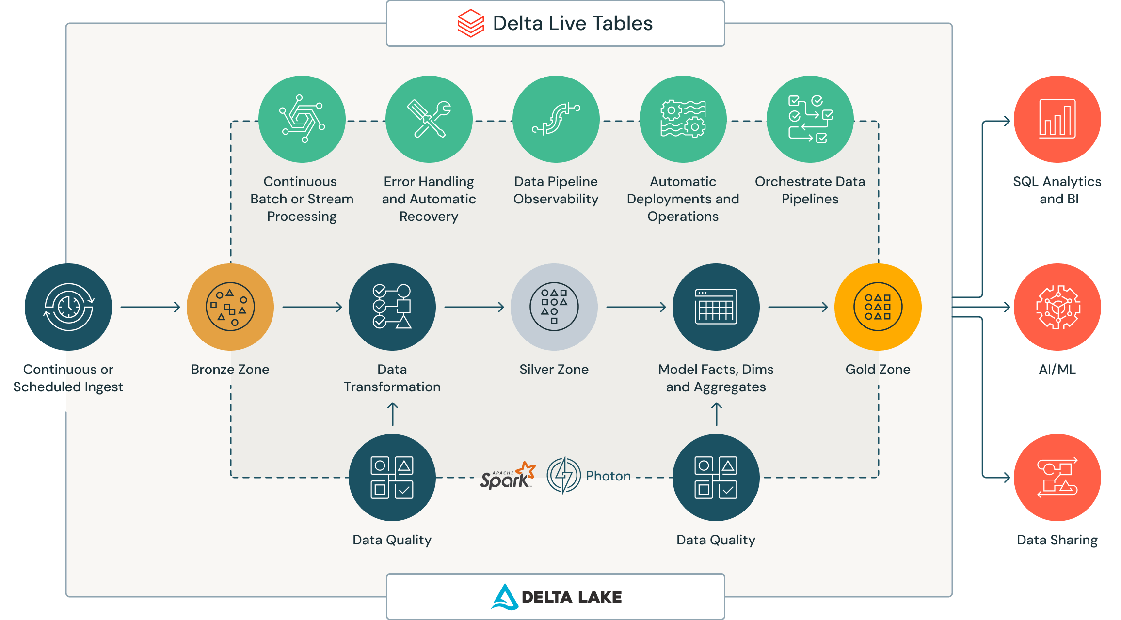
Delta Live Tables is a declarative framework for building reliable, maintainable, and testable data processing pipelines. You define the transformations to perform on your data and Delta Live Tables manages task orchestration, cluster management, monitoring, data quality, and error handling.

Slide 4
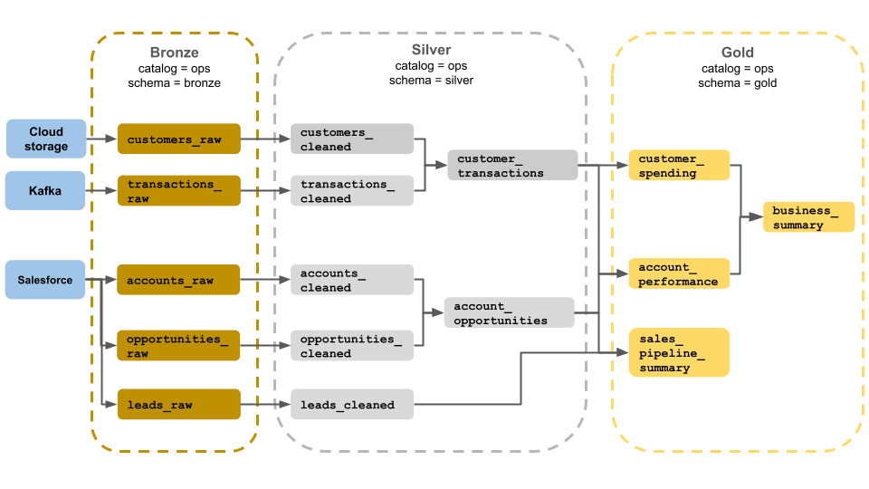
The Medallion architecture
This example of a medallion architecture shows bronze, silver, and gold layers for use by a business operations team. Each layer is stored in a different schema of the ops catalog.
Bronze Layer: This is the raw data layer where data is ingested in its original format. It is typically unprocessed and may contain duplicates, missing values, and other inconsistencies.
Silver Layer: This is the cleaned and enriched data layer. Data in this layer has been processed to remove duplicates, handle missing values, and apply basic transformations1. It is more structured and ready for further analysis.
Gold Layer: This is the curated and aggregated data layer. Data in this layer is highly processed, aggregated, and optimized for business intelligence and analytics1. It is ready for consumption by end-users and applications
Notes:
The Medallion architecture is a data design pattern used to logically organize data in a lakehouse, with the goal of incrementally and progressively improving the structure and quality of data as it flows through each layer of the architecture. It consists of three layers: Bronze, Silver, and Gold.
Layers of the Medallion Architecture:
Bronze Layer: This is the raw data layer where data is ingested in its original format. It is typically unprocessed and may contain duplicates, missing values, and other inconsistencies1.
Silver Layer: This is the cleaned and enriched data layer. Data in this layer has been processed to remove duplicates, handle missing values, and apply basic transformations1. It is more structured and ready for further analysis.
Gold Layer: This is the curated and aggregated data layer. Data in this layer is highly processed, aggregated, and optimized for business intelligence and analytics1. It is ready for consumption by end-users and applications

Slide 5
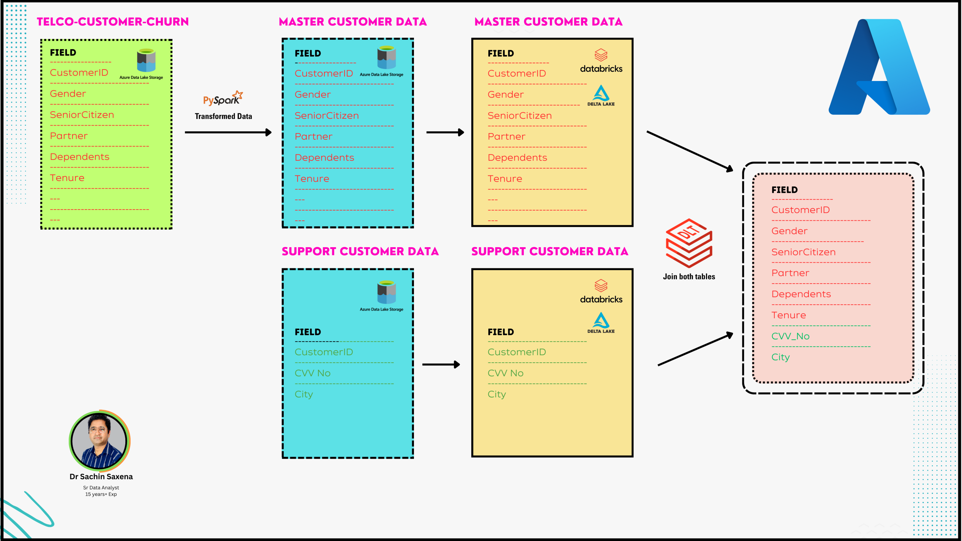

Slide 6
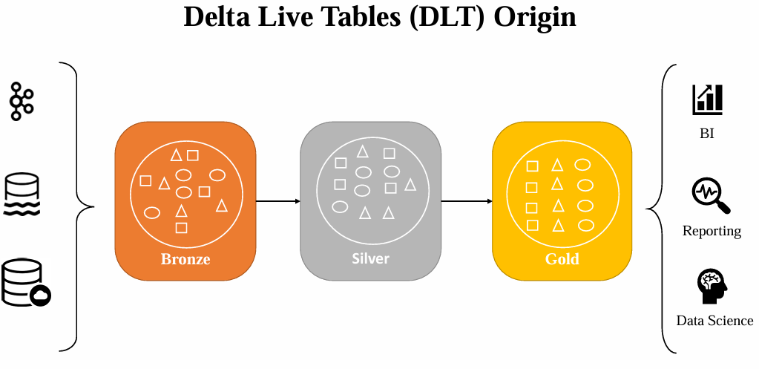
Delta Live Tables (DLT) revolutionizes the way you build and manage data pipelines. With a declarative approach, you can define transformations in simple SQL or Python while ensuring data quality and automating operations seamlessly.
What’s inside this guide?
✔️ Overview of the Databricks Lakehouse platform
✔️ Key differences between Data Warehouses and Data Lakes
✔️ Building ETL pipelines with DLT
✔️ Automating data ingestion using Auto Loader
✔️ Implementing Change Data Capture (CDC) with DLT

Slide 7
What is DLT in Databricks and How Can It Simplify Your Data Pipelines?
What is DLT?
DLT (Delta Live Tables) is a tool in Databricks that helps you easily build and manage data pipelines.
It automates data tasks, ensuring your data is always clean, up-to-date, and ready for analysis.
Whether you're working with large data sets or just a few tables, DLT simplifies the process.
How does DLT work?
Simple Setup: Use basic SQL or Python to define your data pipelines. No complex coding required.
Automated Data Management: DLT takes care of cleaning, organizing, and updating your data without you having to lift a finger.
Built-in Data Checks: It ensures your data meets quality standards by running checks automatically.
Data Versioning: Easily track changes in your data and see how it has evolved over time.

Slide 8
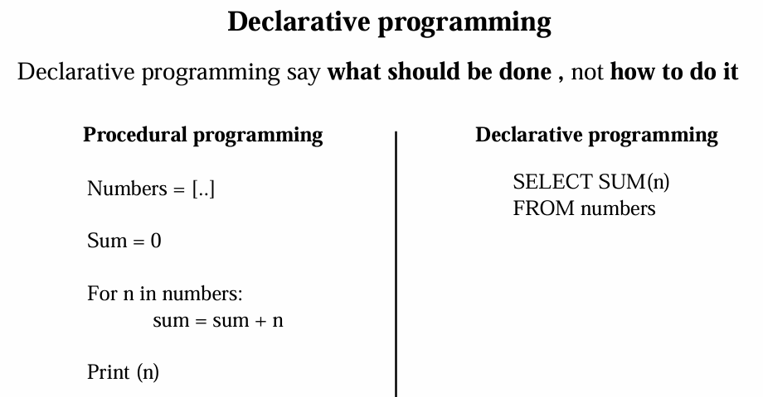

Slide 9
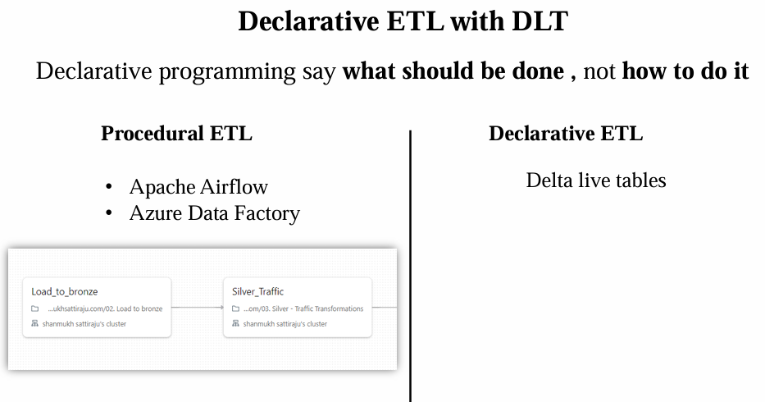

Slide 10
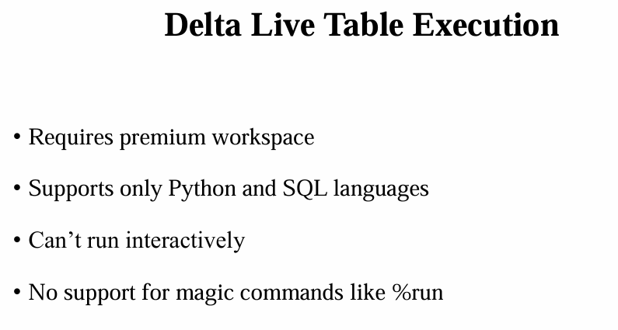

Slide 11
